Slide 1


Presidency
Presidency
School of Artificial Intelligence and Advanced Computing

Slide 2
AI Assistant for Policy Document Comparison and Impact Analysis
CSS7102- Mini Project Review-1
Batch Number:
Roll Number | Student Name
20231CAI0012 | Rhivu Dutta
20231CAI0161 | T Dhanush
20231CAI0042 | Shrivyaaz Sharma JB
20231CAI0016 | DHAKSHINA SHWAR MOHANKUM AR
Under the Supervision of,
Mr. Sachin V Roikar
Associate Professor
School of Computer Science and Engineering
Presidency University
Name of the Program: CSS7102- Mini Project
Name of the HoD: Dr.Zafar Ali Khan
Name of the Program Project Coordinator: Ms. Suma N G
Name of the School Project Coordinators: Dr. Sampath A K

Slide 3
Content
Problem Statement
Github Link
Analysis of Problem Statement
Timeline of the Project
References

Slide 4
Problem Statement Number: PSAIAC_27
Organization: Presidency University
Category (Hardware / Software / Both) : Software
Problem Description: Policy makers and administrators routinely compare lengthy documents such as regulations, contracts, and institutional policies to understand changes and implications. An AI assistant that highlights differences, maps them to affected stakeholders, and suggests impact narratives could streamline deliberation. The project should explore document alignment techniques, domain-specific ontologies, and interfaces that help users navigate from high-level summaries to detailed clause-level evidence.
Difficulty Level: Hard

Slide 5
Github Link
Github Link:
https://github.com/Rhivu10/ClauseLens

Slide 6
Analysis of Problem Statement
Technology Stack Components:
Frontend & Networking:
1.1 StreamLit: Python framework for building the web UI
1.2 Zrok: Secure tunneling software
2. AI & Machine Learning:
2.1 PyTorch: Running tensor operations and managing GPU acceleration
2.2 HuggingFace: Core Library to downloading models
2.3 BitsandBytes: Quantization of Large models
3. Document Processing & Retrieval:
3.1PyMuPDF: PDF Parsing
3.2 ChromaDB: Text embeddings for RAG

Slide 7
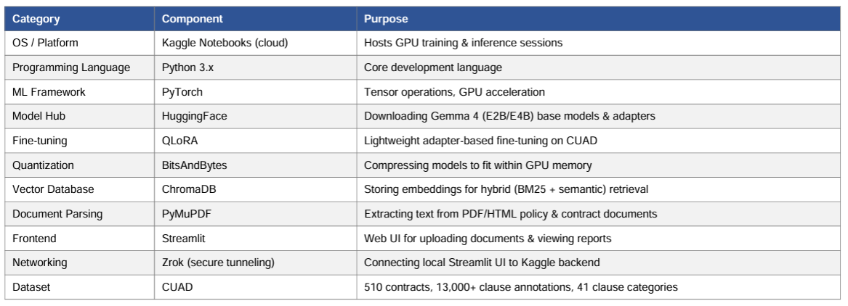
Analysis of Problem Statement (contd...)
Software and Hardware Requirements:

Slide 8
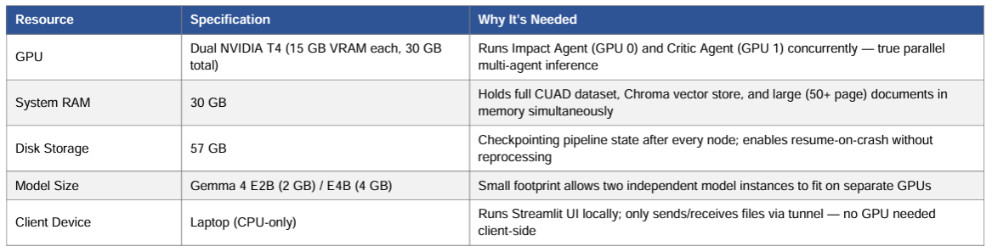
Analysis of Problem Statement (contd...)

Slide 9
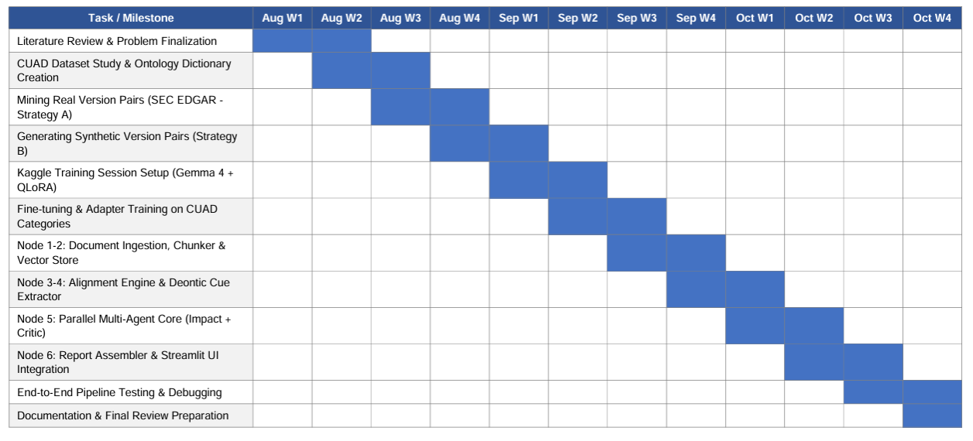
Timeline of the Project (Gantt Chart)

Slide 10
References (IEEE Paper format)
A. Suresh, M. N. H. N. M. N. et al., "LegDiff: Fine-Grained Semantic Comparison of Legal Documents Using Large Language Models," in Proceedings of the 64th Annual Meeting of the Association for Computational Linguistics: Student Research Workshop (ACL SRW), 2026.
M. Umer, M. M. Hassan, et al., "Evaluating Knowledge-Based Approaches for Legal Text Analysis: A Benchmark Study," Machine Learning with Applications, vol. 17, 2026.
K. Chalkidis, I. Androutsopoulos, N. Aletras, et al., "Natural Language Processing for the Legal Domain," ACM Computing Surveys, vol. 56, no. 3, pp. 1-38, 2023.
S. Mandal, N. K. Sahu, et al., "Legal Case Document Similarity: You Need Both Network and Text," arXiv preprint arXiv:2209.12474, 2022.
K. Chalkidis, I. Androutsopoulos, M. Malakasiotis, et al., "LexGLUE: A Benchmark Dataset for Legal Language Understanding in English," in Proceedings of the 60th Annual Meeting of the Association for Computational Linguistics (ACL), 2022, pp. 4310-4330.

Slide 11


